Slide 1

Gene Regulation Networks
Week 2 Workshop

Slide 2
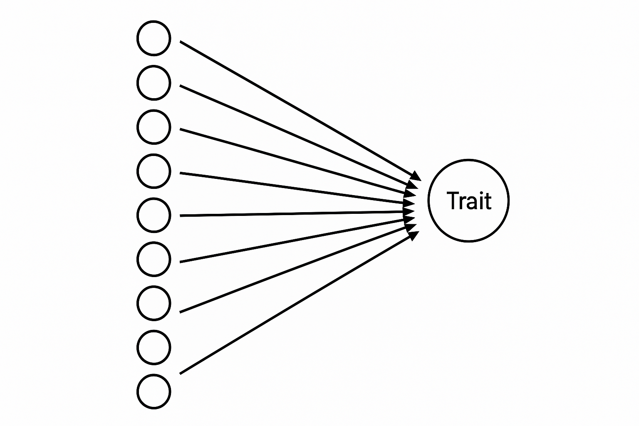
Complex traits depend on many genes
E.g.:
Height
Schizophrenia
Heart disease
1000+ Genes
Notes:
Phenotype driven by genes
Simple traits (ex. hair color) have simple association
Mendelian, one gene affects trait
Complicated traits can be controlled by multiple traits
Heart disease controlled by cholesterol metabolism AND vascular health
“Small effect” loci add up to a “complex trait”
Many of these genes are just regulators of gene expression processes
Genes that do core functions are generally associated with beneficial traits
Biological context:
Any phenotype is driven by genes. Classically, this is often seen as the presence of working or not working copies (Mendelian genetics). When we look at populations and correlate genomic variations to simple traits like hair color, we can identify loci that are highly associated. Some other traits that may be simply associated are certain cancers that occur with the loss of function of a small number of loci. On the other hand, phenotypes such as heart disease susceptibility might be controlled by multiple underlying independent traits like cholesterol metabolism or vascular health, making it a disease regulated by what is considered multiple “small effect” loci that add up to the manifesting of a “complex trait”. This has driven people in popgen to work on engineering increasingly niche reporter traits of these more complex traits to try and genetically dissect the big thing of interest. What’s happened is that people are able to circle off similar sets of genes, but not all of them are enzymes that do metabolic functions. Instead, many of these genes in the bag are regulators of gene expression processes like transcription and translation. Transcription is much better studied between the two due to the existence of microarray and RNA-seq technologies.
Refresher graphic on gene structure and regulatory mechanisms:
Declarative titles
Mostly figures

Slide 3
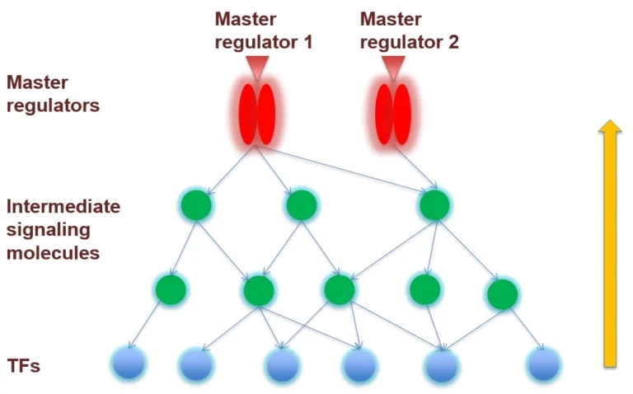
A few genes, called master regulators, sometimes exist that influence many genes related to a complex trait
Genes
Notes:
Genetically modifying genes that do core functions would not be beneficial
Instead prioritize genetically modifying regulatory genes
Look at the “master regulator” (transcription factor)
Looking at one gene (ex. a protein) won’t impact productivity, instead, look at the “master regulator”
Another real-world purpose: In plant biology/agriculture legislation, knocking out a gene (CRISPR targeted) is not considered “Genetic Modification” because there’s no foreign genetic material introduced. Genes that do core functions are going to deeply associated with beneficial traits, things like nutrient uptake and photosynthesis enzymes. Doing genetic modifications to these will usually not help us to make better plants. With our bag of associated genes to a trait of interest, how do we prioritize the one for genetic engineering? (We pick the one regulating all the other genes) Picture dialing up one photosynthesis enzyme won’t do much to improve plant productivity without also dialing up all the other biological pathways, so we have to look for the gene that is the “master regulator” (aka transcription factor). With the scheme pictured, how might one use our next generation sequencing to find this answer? I’ll first talk about gene expression (RNA-seq)
Repressor binds to operator, stopping transcription. Metabolite interferes with repressor, allowing transcription
Get data
Filter data to set of interesting genes (or not!)
Run analysis
Correlation between genes
Tools: GENIE3, Random Forest, XGBoost, CatBoost
Correlation between genes to find the master regulator, one gene would be regulating the transcription factors and thus the other genes. So finding the master regulator can, in the long run, help predict the genotype of certain traits.

Slide 4
How can we use next-generation sequencing to find the master regulator?

Slide 5
Correlation of Genes → Coregulation
Goal - Build a coexpression network based on gene expression correlations (based on statistics)
Genes that are part of the same module (cluster of coexpressed genes) are likely to be functionally related (showing coregulation)
WGCNA - Weighted Gene Co-Expression Network Analysis
R Package
Considers genes as nodes, edges by their correlation strength
Utilizes soft thresholding to maintain strong correlations between genes alongside the whole network connectivity
Eigengene - Used in DEA, principal component of expression data
Notes:
Another popular method is high correlation between (A) and (B). This is implemented by the highly cited and used package “WGCNA”. Notably “correlation” can be calculated in numerous ways and there’s different reasons to pick the correlation metric based on the distribution of your genes of interest, but that’s pretty deep nuance. Linear Pearson’s correlation coefficient is standard.

Slide 6
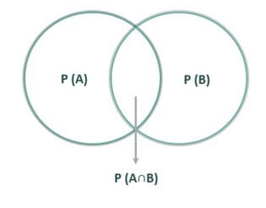
Conditional Probability
P(A∣B)=P(A∩B)​ / P(B)
Notes:
Probability is the likelihood of an event to occur
favorable outcome / total outcomes
Conditional probability is the likelihood of an event occurring given another event
Probability ranges from 0 - 1
Ex. probability of rolling a 6 on a standard die is ⅙
"P of A given B equals P of A intersect B over P of B."
The probability of A given B is equal to the probability of A and B occurring together, divided by the probability of B

Slide 7
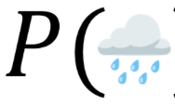





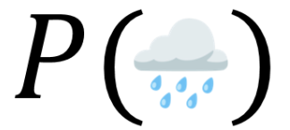

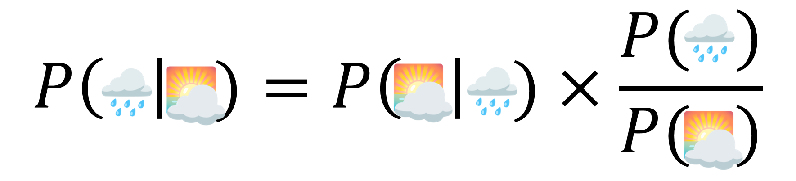
Bayes Rule
Conditional Probability
Joint probability
Bayes Rule
Notes:
Image depicts probability of rain at sunrise
By combining conditional probability and joint probability rules, we can get bayes rule. Here we have an example with weather, where we can use bayes rule to find the probability of rain happening at sunrise.
P of rain given sunrise equals P of sunrise given rain times P of rain over P of sunrise

Slide 8

Try it yourself
1% of people have a genetic variant. The test catches it 95% of the time, and 5% of all tests are positive. What’s the chance someone who tests positive actually has the variant?
P(A) = 0.01
P(B|A) = 0.95
P(B) = 0.05
P(A|B) = ?
19%
Notes:
First find the different probabilities within the problem, then input them into Bayes rule to find the probability of someone who tests positive actually having the variant?

Slide 9
Bayesian Tree/ Random forest?

Slide 10
Bayesian Tree based methods perform best Genie3
Another is how well the expression of (A) is predictive of (B)’s expression. This seems quite similar to the above, but some non-linear methods can account for real cases like “What if (A) needs (C) to also be present to co-promote (B)?” A linear machine learning implementation of that could be modeled based on interaction terms, like B ~ A + C + A:C (That’s the R convention for modelling variables). Or, you can more elegantly handle the modeling of B based on a decision tree (Random Forest, XGBoost, CatBoost). The software package “GENIE3” most famously has solved gene regulatory network inference using the tree-based method.
Notes:
Introduce Idea by genie3
Introduce genie3
Do it in practice → workshop side of it

Slide 11
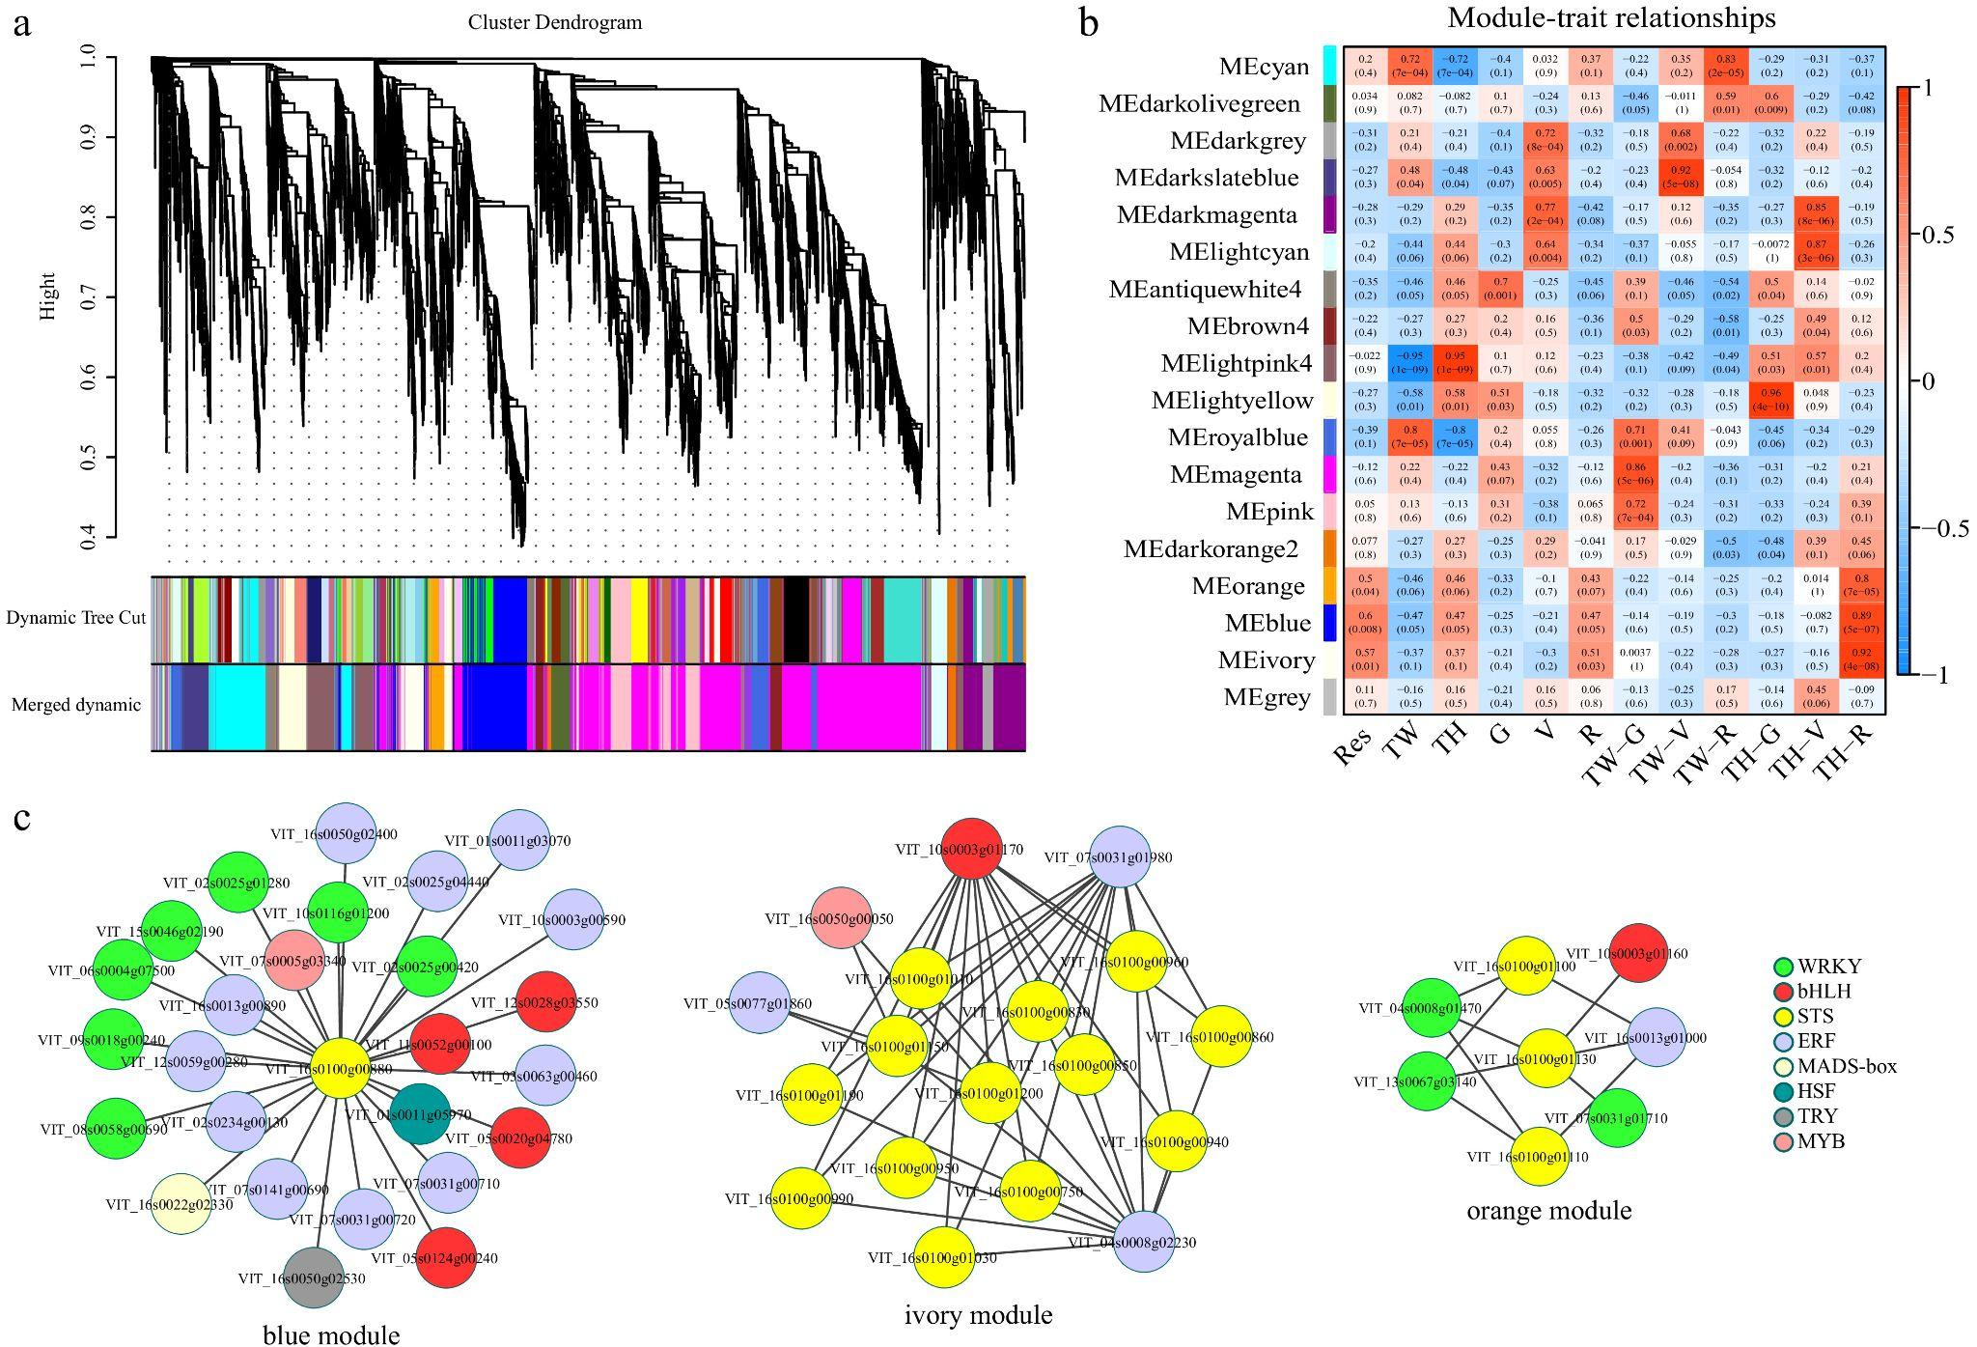

Slide 12
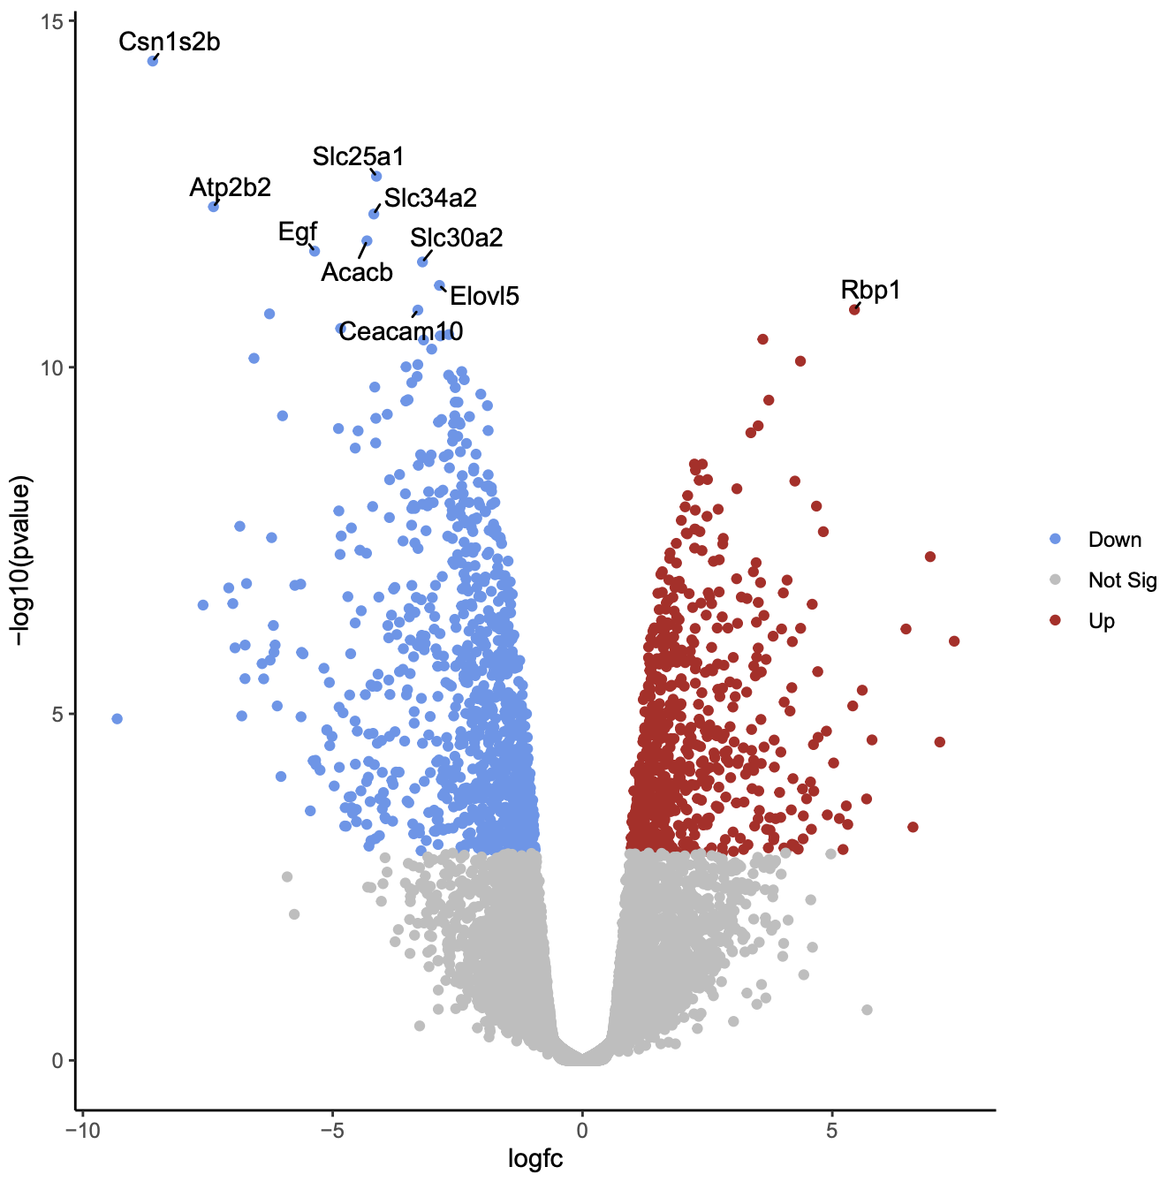
How do we get genes that we are interested in?
Goal - Identify genes of interest
Specifically, genes encoding transcription factors
Reducing Dimensionality
Can use a Volcano Plot to visualize
Comparing p value with fold change
Sample Packages - WGCNA, identifies eigengenes

Slide 13
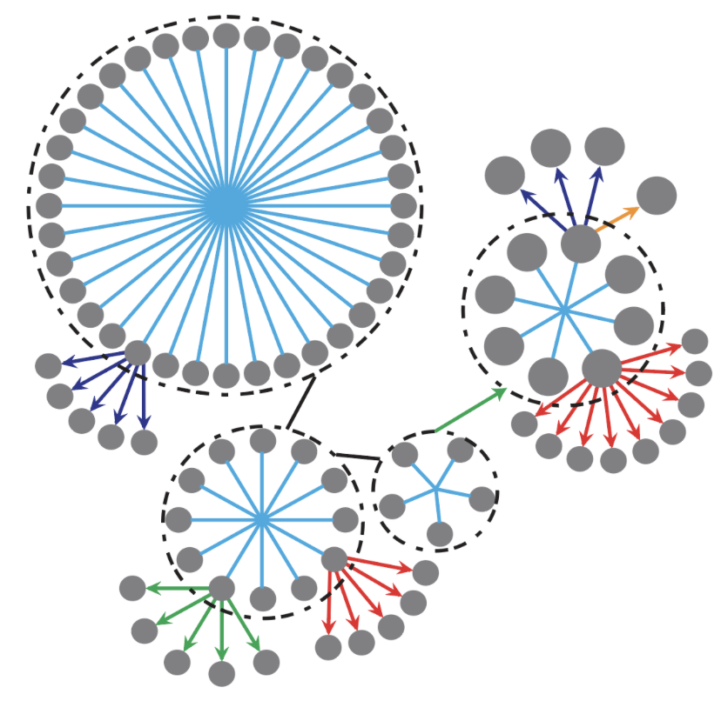
Gene regulation is useful in many subfields and is actively used-in and improved by many labs at UCSD
To name a few:
Ideker Lab
Wang lab
Ay Lab (La Jolla Institute for Immunology)
Boolean Lab (Sahoo)
Notes:
Ideker Lab
Mapping of genetic and molecular networks, machine learning for predictive oncology, network biomarkers for cancer and neuropsychiatric disease
Wang lab
Gene regulatory principles, biophysical modeling, structure of 3D genome
Ay Lab (La Jolla Institute for Immunology)
Genetic and epigenetic bases of gene regulation, constructing regulatory networks, 3D genome modeling
Boolean Lab, PI is Dr. Debashis Sahoo
Boolean networks
“regulator gene A is considered to activate another gene B if in all the samples, gene A is always transcribed at high count number when gene B is highly expressed too. (A) represses (B) if in the samples where (A) is expressed, (B) is never expressed”
Another technique for gene regulation networks

